Slide 1

Texas OSHCON Safety & Health Program
Free & Confidential OSHA Safety Compliance Help
Workplace Safety Resources
TX OSHCON Website
Darrell Lofton– Texas OSHCON Team Manager
darrell.lofton@tdi.Texas.gov 800.252.7031 Ext 33572
Barb Fox – Workplace Safety/Texas OSHCON Outreach
barb.fox@tdi.texas.gov 800.252.7031 Ext 44648
Disclaimer: This information has been developed to help employers, workers, and others improve workplace health and safety. This information is a tool rather than an exhaustive statement of an employer’s legal obligations, which are defined by statute, regulations, and standards. To the extent that this information references practices or procedures that may enhance health or safety, but which are not required by a statute, regulation, or standard, does not create additional legal obligations. OSHA may modify rules and interpretations in light of new technology, information, or circumstances. To keep up to date on such developments or to review information on a wide range of occupational safety and health topics, visit OSHA’s website at www.osha.gov or contact OSHCON at www.txoshcon.com.

Slide 2
Topics - Review
Texas OSHCON Program
  Who we help
  Who we are and what we do
  Benefits of using
  OSHA vs OSHCON visits
  Workplace Safety Resources
OSHA
  Required poster
  300 log information
  Reporting injuries
Q&A

Slide 3



Slide 4

In Texas, private sector employers
with one or more employees are required to comply with OSHA rules, regulations, and standards to provide a safe & healthy workplace for their workers
Not covered under the OSH Act:
  public sector (state and local governments)
  self-employed;
  immediate family members of farm employers; and
  workplace hazards regulated by another federal agency
  (for example, the Mine Safety and Health
  Administration, Department of Energy, or
  the Coast Guard).
*An employer’s workers may include:
Full-time workers
Part-time workers
Temporary workers
Seasonal workers
Workers in multi-employer worksites

Slide 5
OSHCON Clients Include...
Agriculture
  Cotton gins
  Grain storage
  Nurseries
Construction
  Commercial
  Residential
Forestry
  Logging
  Sawmills
Health care
  Medical and dental clinics
  Nursing and residential care facilities
Mining
  Oil and gas
Manufacturing
  Wood
  Primary metals and machining
  Bottling
  Meat processing
  Food products
  Concrete
Service industries
  Part and body shops
  Mechanic shops
  Landscaping
  Dry cleaners
Veterinary clinics
Warehousing

Slide 6

Texas OSHA on-site Consultation Workplace Safety Program
Texas OSHCON consultants:
Are employees of DWC, not federal OSHA.
Are separate from federal OSHA enforcement activities
Activities are free and confidential.
Do not issue citations.
Do not assess fines.
Texas OSHCON is funded 90% by federal OSHA.
Notes:
Every state is required to have an OSHA free and confidential on-site consultation program to help small businesses and our program is called the Texas Occupational Safety and
Health Consultation program or more commonly referred to
as Texas OSHCON or OSHCON
Texas OSHCON is a free and confidential service designed to help small business employers identify hazards, improve workplace safety, and ensure OSHA compliance, through onsite safety consultations
We are funded 90% by an OSHA grant
We are not federal employees we are state employees
And we are separate from federal OSHA enforcement
We do not issue citation, fines or warrants
our services, again, are free and confidential

Slide 7

Texas OSHCON Safety & Health Program
The Texas OSHA Consultation Program (OSHCON) offers no-cost confidential help for Texas businesses.
Texas OSHCON consultants are available:
In-person for on-site consultations.
For video conferencing.
Via email.
Via phone (go to txoshcon.com for consultants’ direct office numbers).
By submitting a request online at txoshcon.com.
Notes:
Our consultants are available:
In-person for on-site consultations
video conferencing
email
phone
Or you can go online to txoshcon.com and submit request then a consultant from your area will get back with you.

Slide 8

Texas OSHCON Consultants
Help you find, reduce, and remove safety and health hazards.
Help you with your safety and health written programs.
Provide training on multiple subjects.
Provide air sampling.
Provide noise monitoring.
Help you understand OSHA standards.
Help you with your OSHA 300/300A and injury/illness recordkeeping logs.
Notes:
Our consultants:
Can help employers find, reduce, and remove hazards in their workplace
Help employers with their required written safety and health programs
Provide hands-on-training
Provide air sampling and noise monitoring
Help you understand OSHA standards associated with your business
Help with your OSHA 300 injury and illness recordkeeping logs
And more…………..

Slide 10
Potential Benefits of Using OSHCON
Culture
Costs
  Direct Costs
  Indirect Costs
Quality Improvement
Productivity
Morale
Notes:
Injury prevention helps to build a stronger, empowered, and positive culture for your employees. Organizations with a strong, empowered, and positive cultures retain their employees and customers.
Most business leaders measure costs on a balance sheet to determine costs to the business. They only see the money going out as direct costs. When a business is operating with no injuries it is difficult for business owners to see the return on investment. It is important to understand that injury prevention or the lack of injury prevention costs a business both directly and indirectly.
What are the direct costs of an injury?
What are the indirect cost of an injury (Total more than direct costs)?
Injury prevention reduces theses costs and increase profitability.
When you have created a strong, empowered, and positive culture and reduced the impact of potential injuries, employees understand how important they are to the business, and this increases their productivity and quality of their work.

Slide 11
Comparison of Services
  OSHA Inspection
  Unannounced
  Fines (up to $16,550) assessed per hazard identified as of Jan 7, 2025.
  May not see results for six months.
OSHCON Visit
Scheduled to fit employer’s need.
No fines
Will typically see report within 20 calendar days.

Slide 12

Free Workplace Safety Resources
www.txoshcon.com

Slide 13
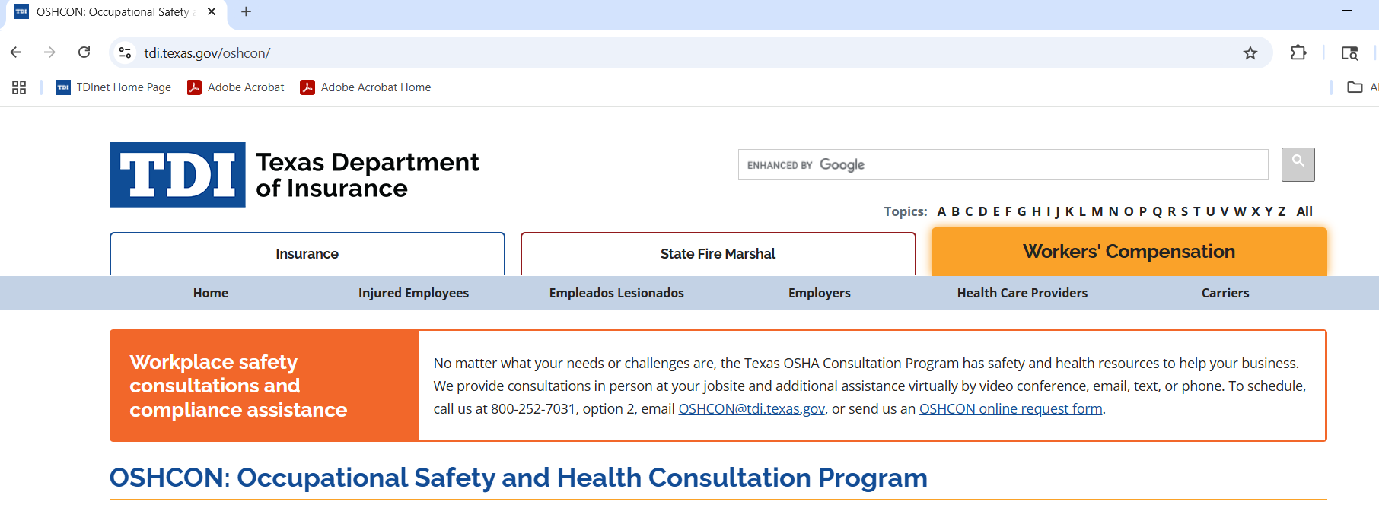
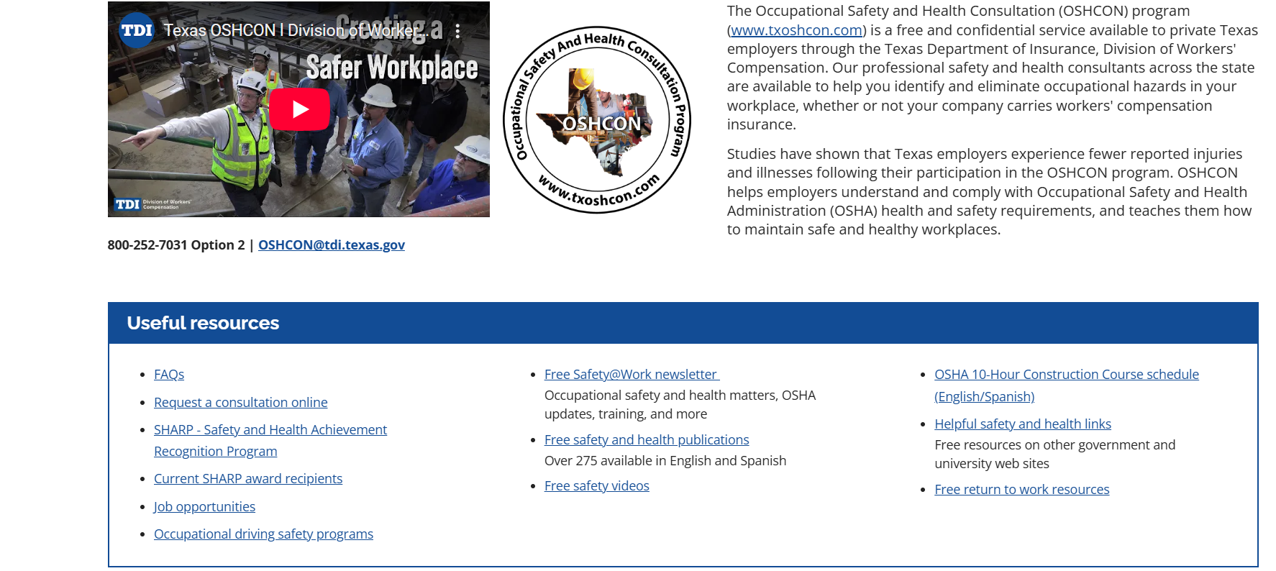
www.txoshcon.com

Slide 14
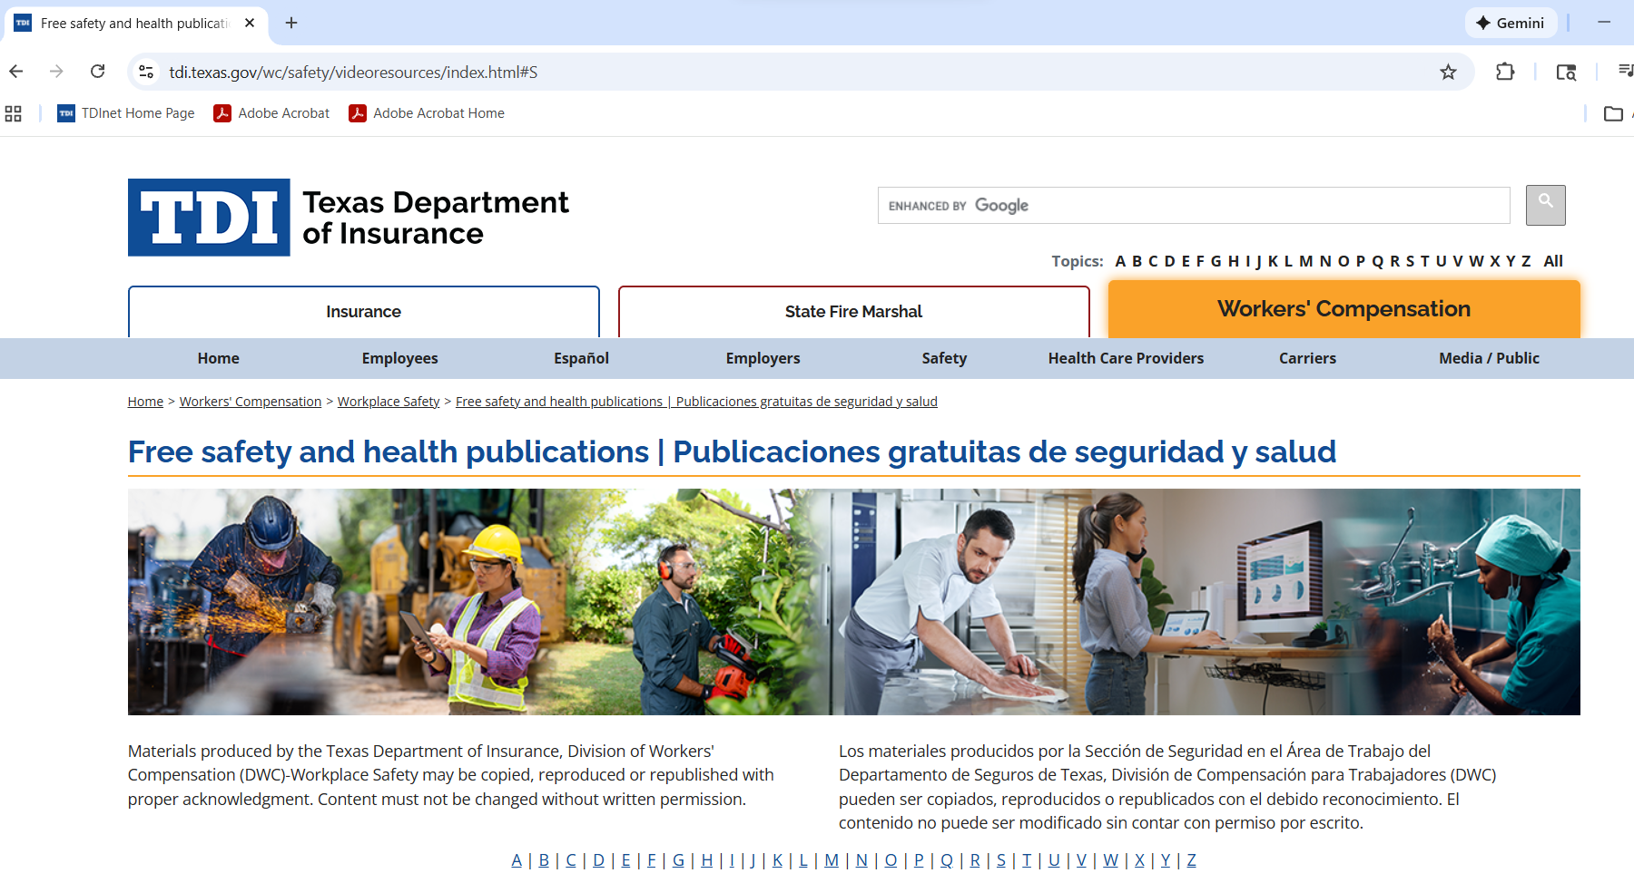
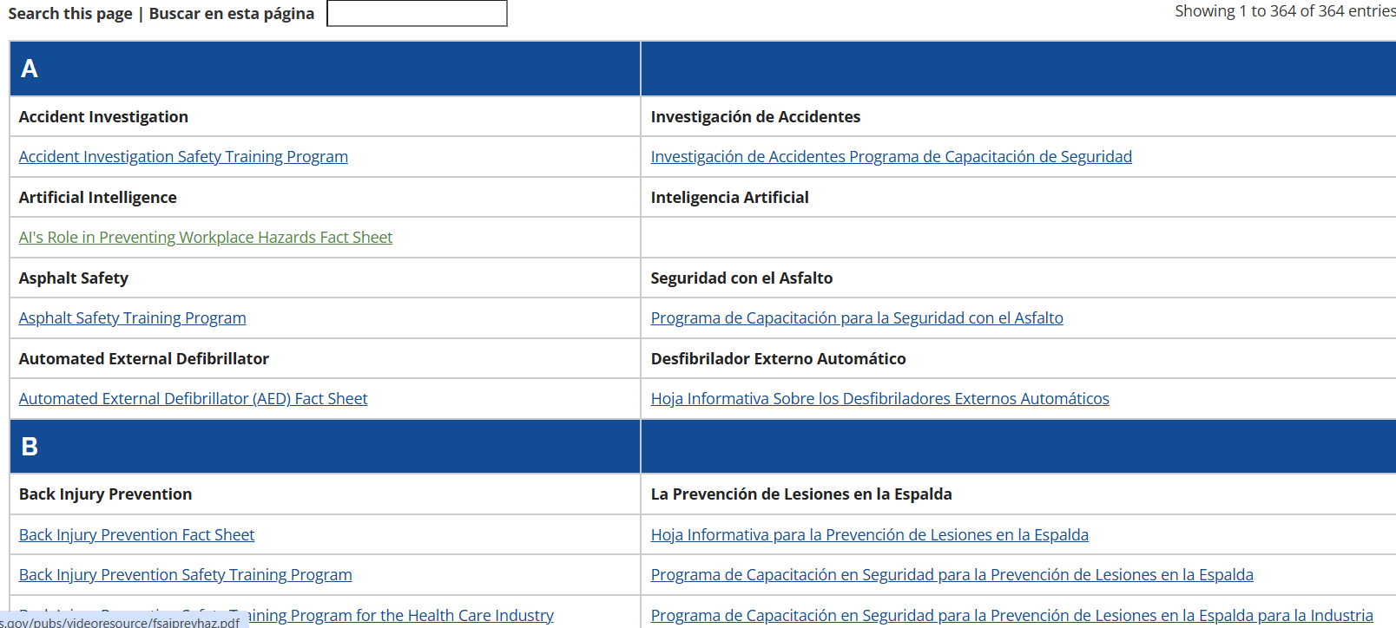
Notes:
Around 400 publications in English & Spanish

Slide 15
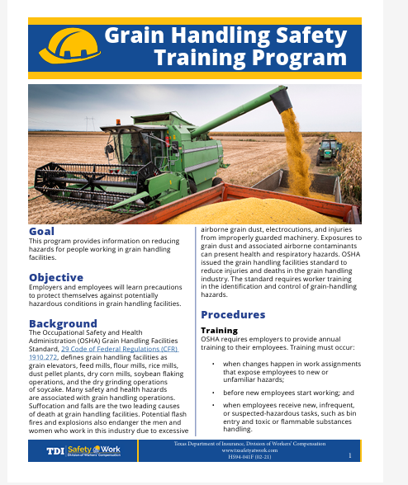

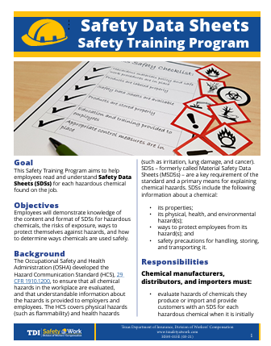


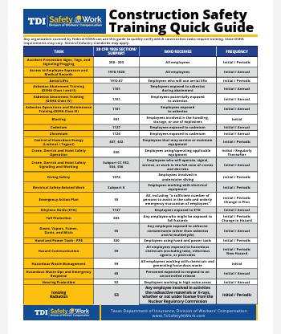
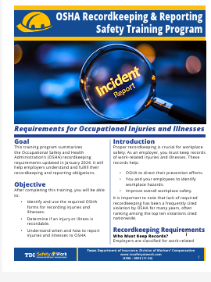
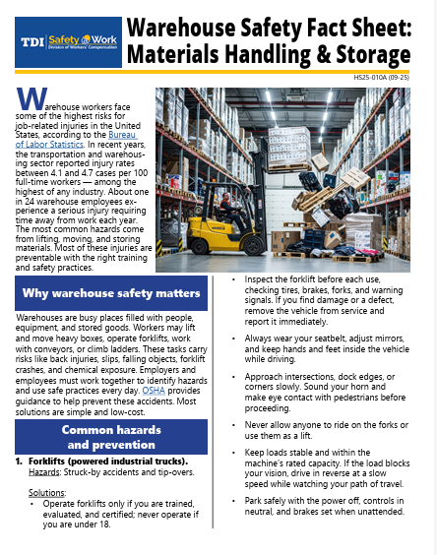
Snapshot of FREE publications

Slide 16
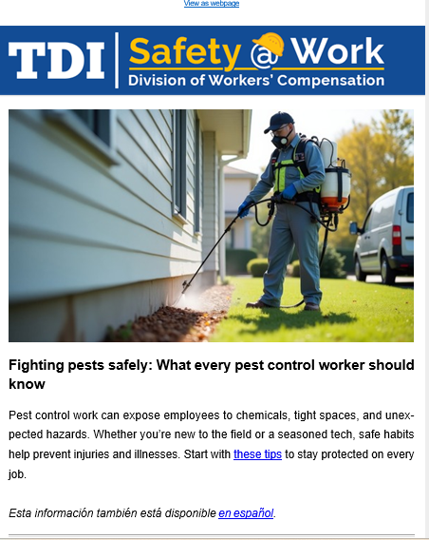

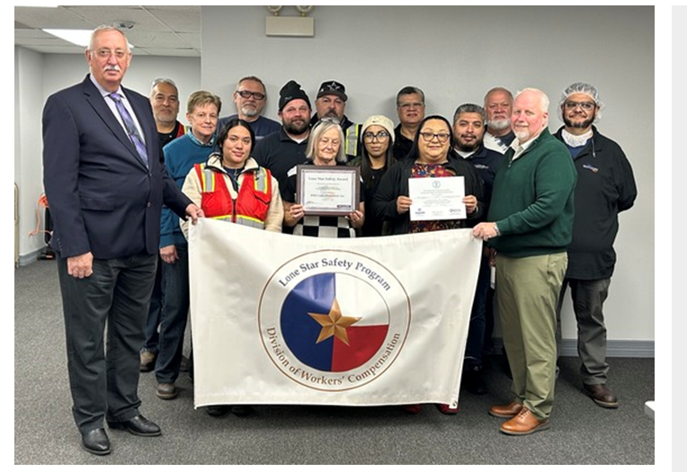
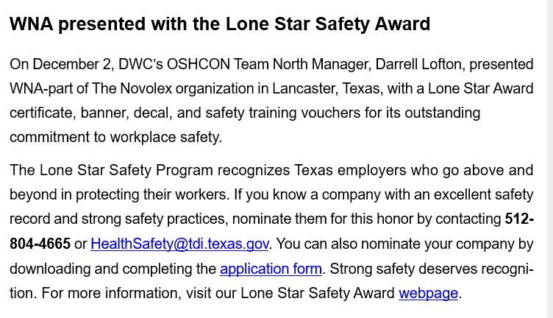


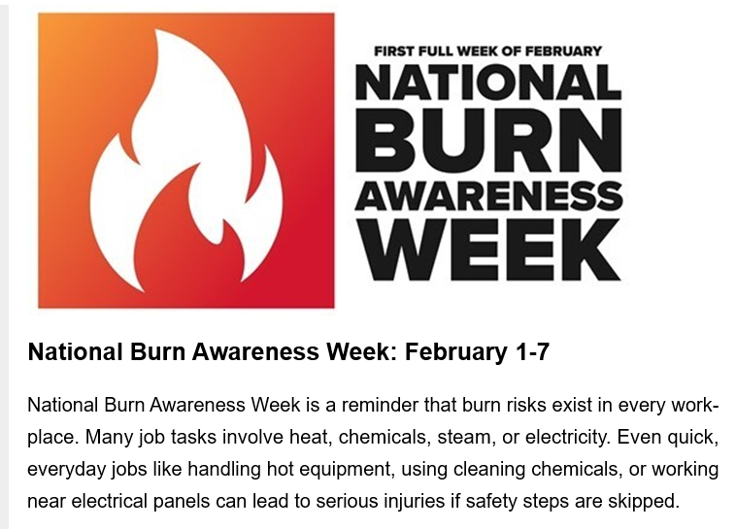
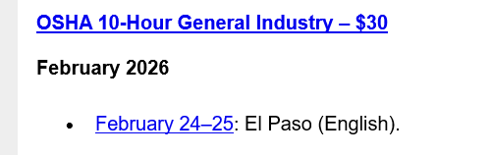
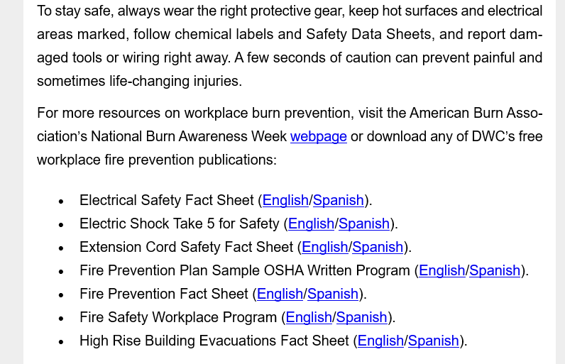


Snapshot of a FREE bi-monthly safety newsletter
The complete list of free publications for download is on the TDI website.
Notes:
Our Safety@Work newsletter gives you the latest news on:
new safety pro seminars;
free OSHA 10-Hour Construction Classes;
low-cost OSHA 30-Hour Construction Classes;
low-cost OSHA 10-Hour General Industry Classes;
other free and low-cost safety training;
quick safety tips you can share with your employees and co-workers;
free and revised safety publications;
free online safety videos;
Occupational Safety and Health Consultation (OSHCON) news;
important OSHA news; and
releases of occupational injury, illness, and fatality data.
Our Safety@Work newsletter gives you the latest news on:
new safety pro seminars;
free OSHA 10-Hour Construction Classes;
low-cost OSHA 30-Hour Construction Classes;
low-cost OSHA 10-Hour General Industry Classes;
other free and low-cost safety training;
quick safety tips you can share with your employees and co-workers;
free and revised safety publications;
free online safety videos;
Occupational Safety and Health Consultation (OSHCON) news;
important OSHA news; and
releases of occupational injury, illness, and fatality data.

Slide 17
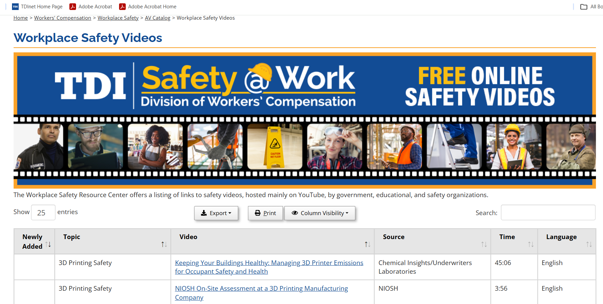
Notes:
More than 1, 300 videos online for viewing

Slide 18
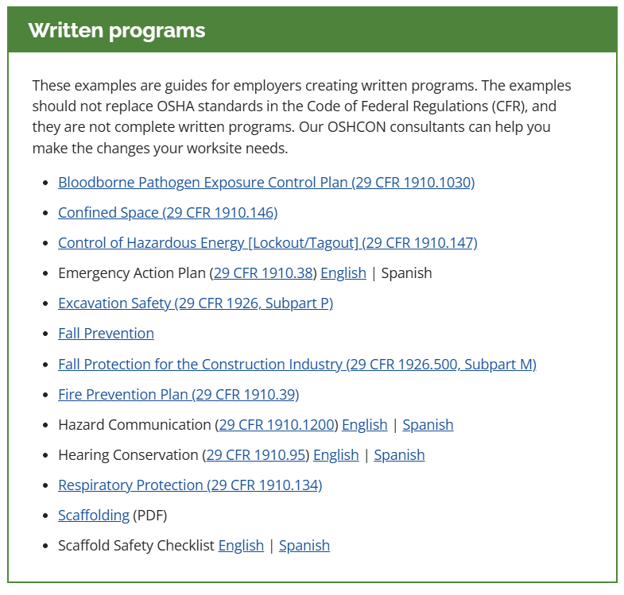

Slide 19
Things To Know…..

Slide 20
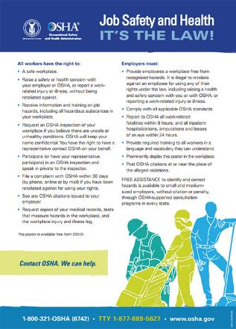
Required OSHA Poster – IT’s the Law
Provide a workplace free from serious recognized hazards.
Train workers in a language and vocabulary they can understand.
Comply with standards, rules and regulations issued under the OSH Act.
It’s Free
It’s Required
Post in a prominent place where workers can see it
This poster is available in many languages
Reproductions or facsimiles need to be at least 8½ inches by 14 inches and printing size is at least 10 pt. (1903.2(a)(3)
www.osha.gov/Publications/poster.html

Slide 21

Did You Know?
The OSHA website is now available in many languages.
Just click on the word "Languages" at the top right of any webpage to select from the translation options.

Slide 22
Injury and Illness 300 Log Recordkeeping
29 CFR 1904
9:40am

Slide 23
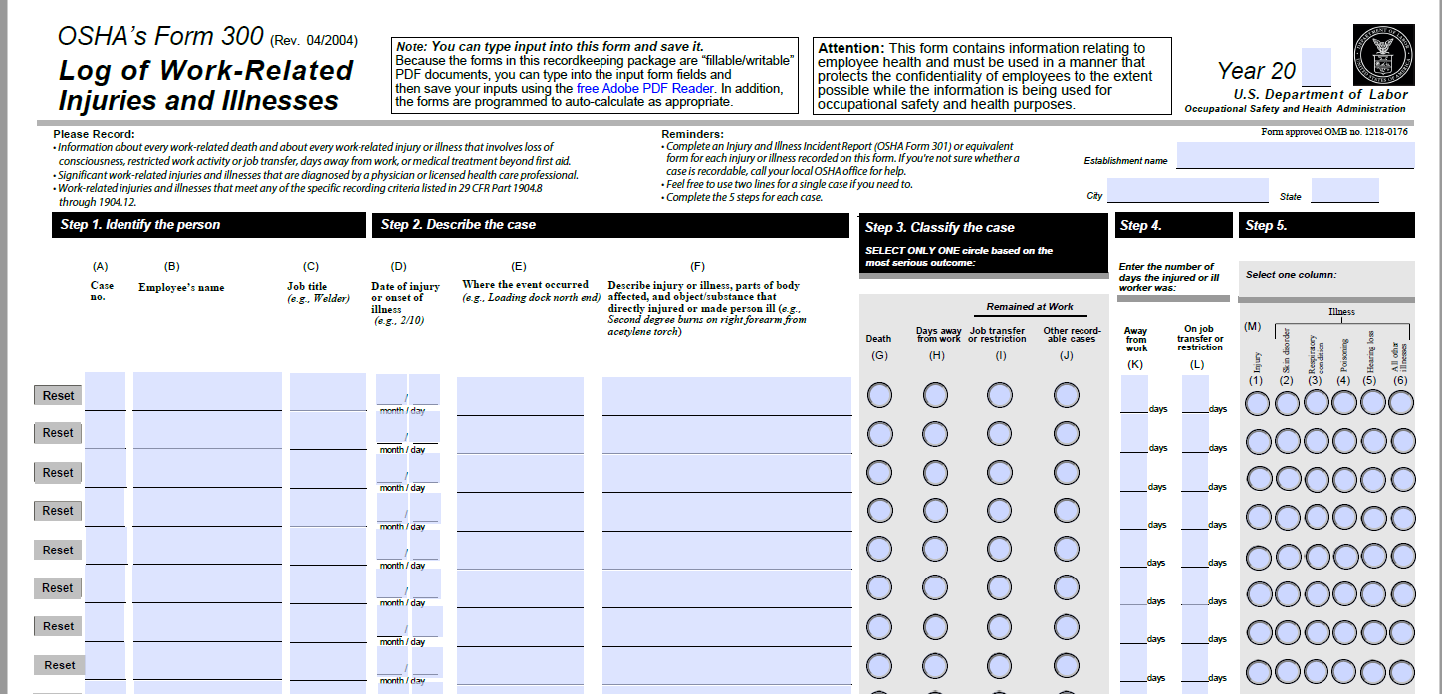
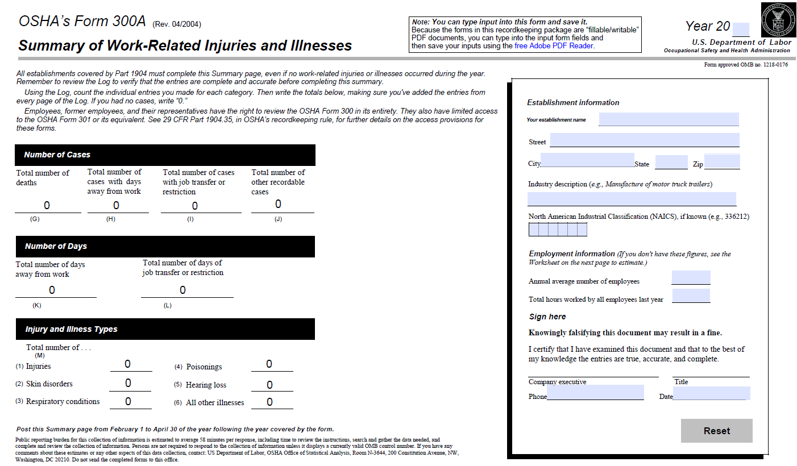
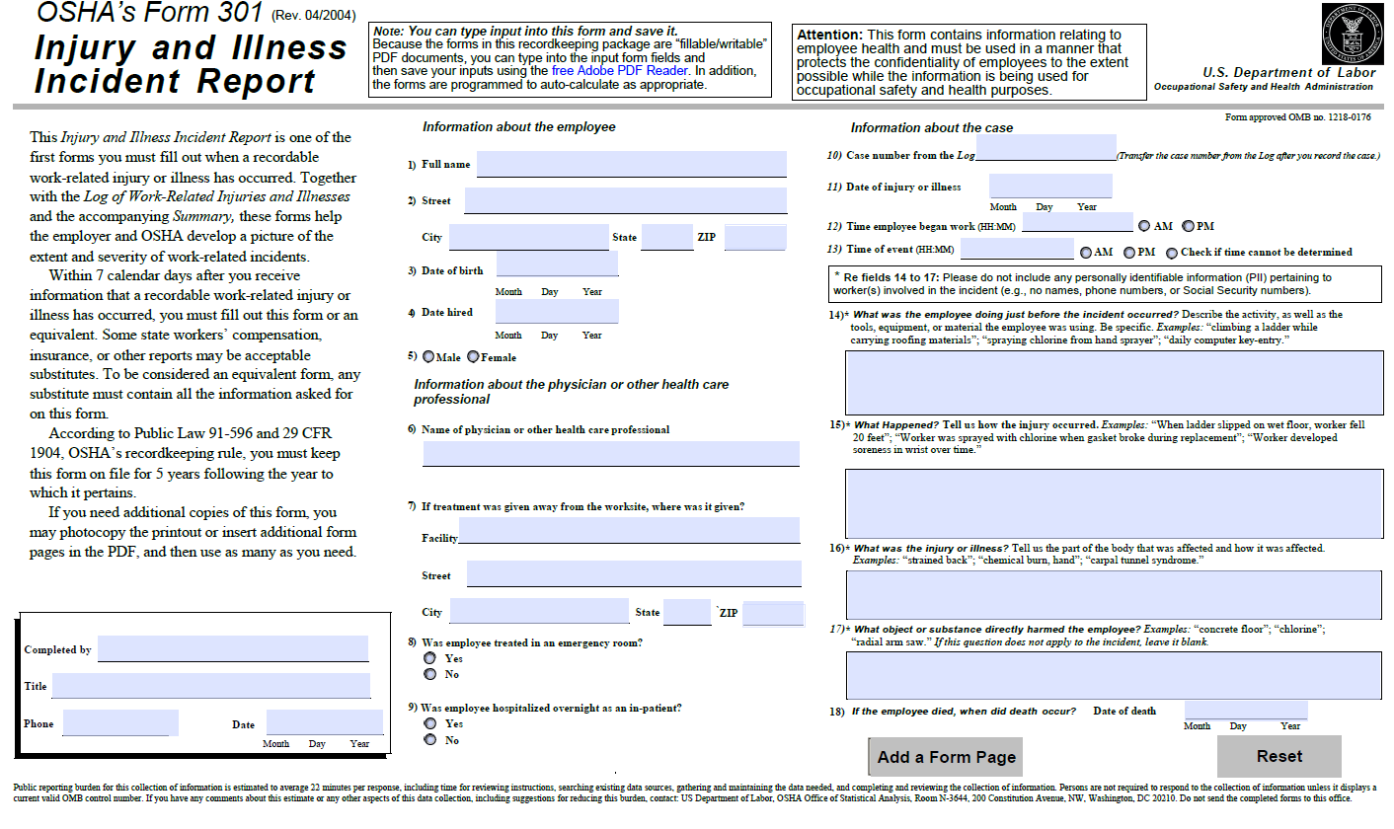
OSHA 300 Series Forms:
Injury and Illness Recordkeeping
OSHA Form 300: Log of Work-Related Injuries and Illnesses
OSHA Form 300A: Summary of Work-Related Injuries & Illnesses
Required to post February 1-April 30
OSHA Form 301: Injury and Illness Incident Report
OSHA 300 log training @ www.osha.gov/recordkeeping/tutorial.html

Slide 24

for Employers Required to Keep Logs
Due by March 2nd
Electronic Submission of 300 Data
Establishments with 100 or more employees in the highest-hazard industries must electronically submit information from their Form 300 Log and Form 301 Incident Report. (Final rule amended federal occupational injury and illness recordkeeping regulation” 29 CFR 1904.41.)
Establishments with 250 + employees will be required to electronically submit their OSHA 300A annually
  Not related to whether they are a ‘high hazard’ or a ‘low hazard’ industry. Its size based…
Establishments with 20-249 employees in certain high hazard industries must continue to electronically submit their OSHA 300A annually.
www.osha.gov/injuryreporting
https://www.osha.gov/recordkeeping/NAICScodesforelectronicsubmission.html

Slide 25

Reporting Fatalities & Severe Injuries
(1904.39)
All employers are required to notify OSHA when an employee dies on the job or suffers a work-related hospitalization, amputation, or loss of an eye
A fatality must be reported within 8 hours
An in-patient hospitalization, amputation, or eye loss must be reported within 24 hours
osha.gov/report.html
Notes:
What is meant by the "loss of an eye"?
Loss of an eye is the physical removal of the eye. This includes enucleation and evisceration.
Does loss of an eye include loss of sight?
No. Loss of sight without the physical removal of the eye is not reportable under the requirements of section 1904.39. However, a case involving loss of sight that results in the in-patient hospitalization of the worker within 24 hours of the work-related incident is reportable.
How do you differentiate between an amputation without bone and avulsions?
If and when there is a health care professional's diagnosis available, the employer should rely on that diagnosis. If the diagnosis is avulsion, the event does not need to be reported. If the diagnosis is amputation, the event must be reported. If there is no available diagnosis by a health care professional, the employer should rely on the definition and examples of amputation included in the regulatory text of section 1904.39. Examples of avulsion that do not need to be reported include deglovings, scalpings, fingernail and toenail avulsions, eyelid avulsions, tooth avulsions, and severed ears. Remember, employers are required to report amputations to OSHA when they learn that the reportable event occurred. The employer must report the event when he or she has information that the injury is a work-related amputation.
If an injured worker is formally admitted to the Emergency Room of a hospital, is this a reportable event?
No, the injured worker must be formally admitted to the in-patient service of the hospital to be a reportable event.
If an employee is admitted to the hospital for Carpal Tunnel surgery, is this reportable?
To be reportable, the in-patient hospitalization must occur within 24 hours of the work-related incident that injured or made the employee ill. Scheduled surgeries that occur beyond this 24 hour period are not reportable to OSHA.
Who determines whether an employee was formally admitted to the in-patient service of a hospital or clinic for care or treatment?
The hospital or clinic makes the determination.
Who should report a fatality or in-patient hospitalization of a temporary worker?
Similar to the requirements in section 1904.31 for recording injuries and illnesses, the employer that provides the day-to-day supervision of the worker must report to OSHA any work-related incident resulting in a fatality, in-patient hospitalization, amputation or loss of an eye.
If my employee spent the night at the hospital, do I have to report an in-patient hospitalization?
OSHA defines in-patient hospitalization as a formal admission to the in-patient service of a hospital or clinic for care or treatment. An overnight stay does not determine whether the case is reportable or not.
If an employee is hospitalized as an in-patient and the only care or treatment provided is from OSHA's "first aid list" (for example if the only treatment is non-prescription medication), does the event become reportable?
Yes. A work-related in-patient hospitalization involving any treatment needs to be reported to OSHA. The reporting requirement in the regulatory text of section 1904.39 does not limit care or treatment to “medical treatment beyond first aid.”

Slide 26

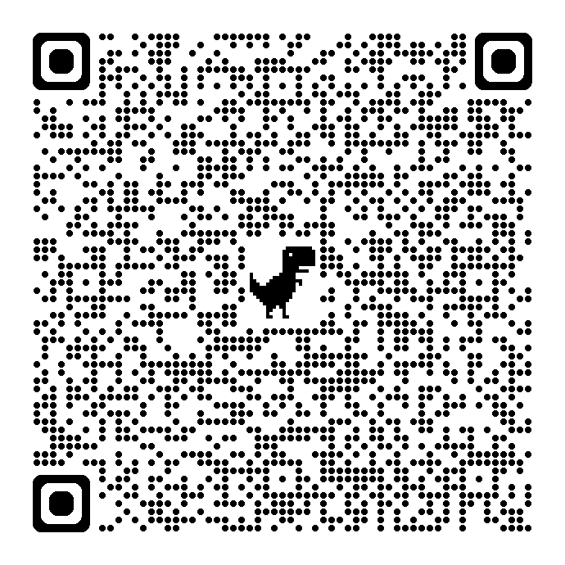
Connect with Texas OSHCON
Darrell Lofton – Team North Manager
darrell.lofton@tdi.texas.gov 800-252-7031 Ext 33572
Barb Fox – Workplace Safety/Texas OSHCON Outreach
barb.fox@tdi.texas.gov 800.252.7031 Ext 44648
OSHCON Website: txoshcon.com
Call OSHCON to request virtual or on-site OSHA compliance help
or to ask safety and health questions 800.252.7031 Option 2
Email OSHCON oshcon@tdi.Texas.gov
Subscribe to Workplace Safety Newsletter: This free bi-monthly
e-newsletter provides the latest safety news, OSHCON compliance help,
OSHA updates, and DWC safety training and educational resources.
Free Safety@Work newsletter
TX OSHCON
Request Form

Slide 27
Questions and Comments
Disclaimer: This information has been developed to help employers, workers, and others improve workplace health and safety. This information is a tool rather than an exhaustive statement of an employer’s legal obligations, which are defined by statute, regulations, and standards. To the extent that this information references practices or procedures that may enhance health or safety, but which are not required by a statute, regulation, or standard, does not create additional legal obligations. OSHA may modify rules and interpretations in light of new technology, information, or circumstances. To keep up to date on such developments or to review information on a wide range of occupational safety and health topics, visit OSHA’s website at www.osha.gov or contact OSHCON at www.txoshcon.com.

