Slide 1

Safety Management System
“Changed My Life!”
Sotero F. Ramirez CSHO, ASP, CSP
Vice President of Risk
DRAKE

Slide 2
TOPICS
Safety Professional Challenges
Safety Management System
Employee Engagement
Simple Reporting
Data (Leading Indicators)
Programs Effectiveness

Slide 3
Safety Professional Challenges?
Employee Information
Training Records
Meeting Records
Equipment List
Equipment Inspection Records
Equipment Maintenance Records
Site Reports
Audit Reports
Emergency Contact
Incident Reporting
Safety Data Sheet
Site Emergency Action Plans
Employee Reviews
Time Off Request
Credit Card Receipts
Employee Acknowledgment
New Hires

Slide 4

Safety Professional Solutions
Excel Spreadsheets
Hard Paper Folders
Notebook Binders
Printers
Scanners
Office Personnel

Slide 5

SOLUTION
“I DO NOT SALE FOR THIS COMPANY”
Safety Management System
  Tyfoo
  eCompliance
  SafetyCulture
  ComplianceQuest
  SafetyAmp
  SiteDocs
  Assure
  SpheraCloud
  Safesite

Slide 6
Must Have!
Employee Engagement – Everybody plugged in
Training – Standard/Custom
Notifications – Proactive/Reactive
Reporting – Simple/Complex
Collect Data – Retrievable/Usable
Safety Program Effectiveness – Good/Bad
Affordable – Management Buy-In

Slide 7
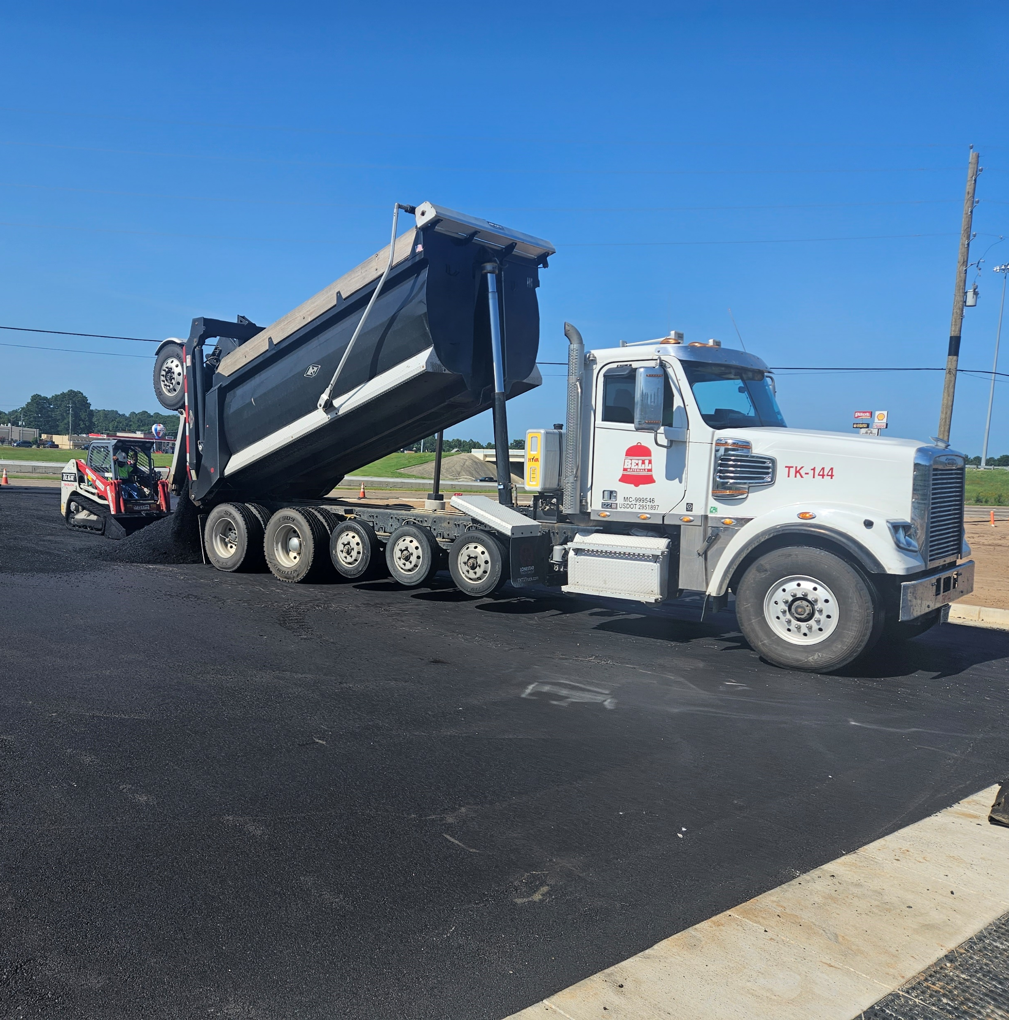
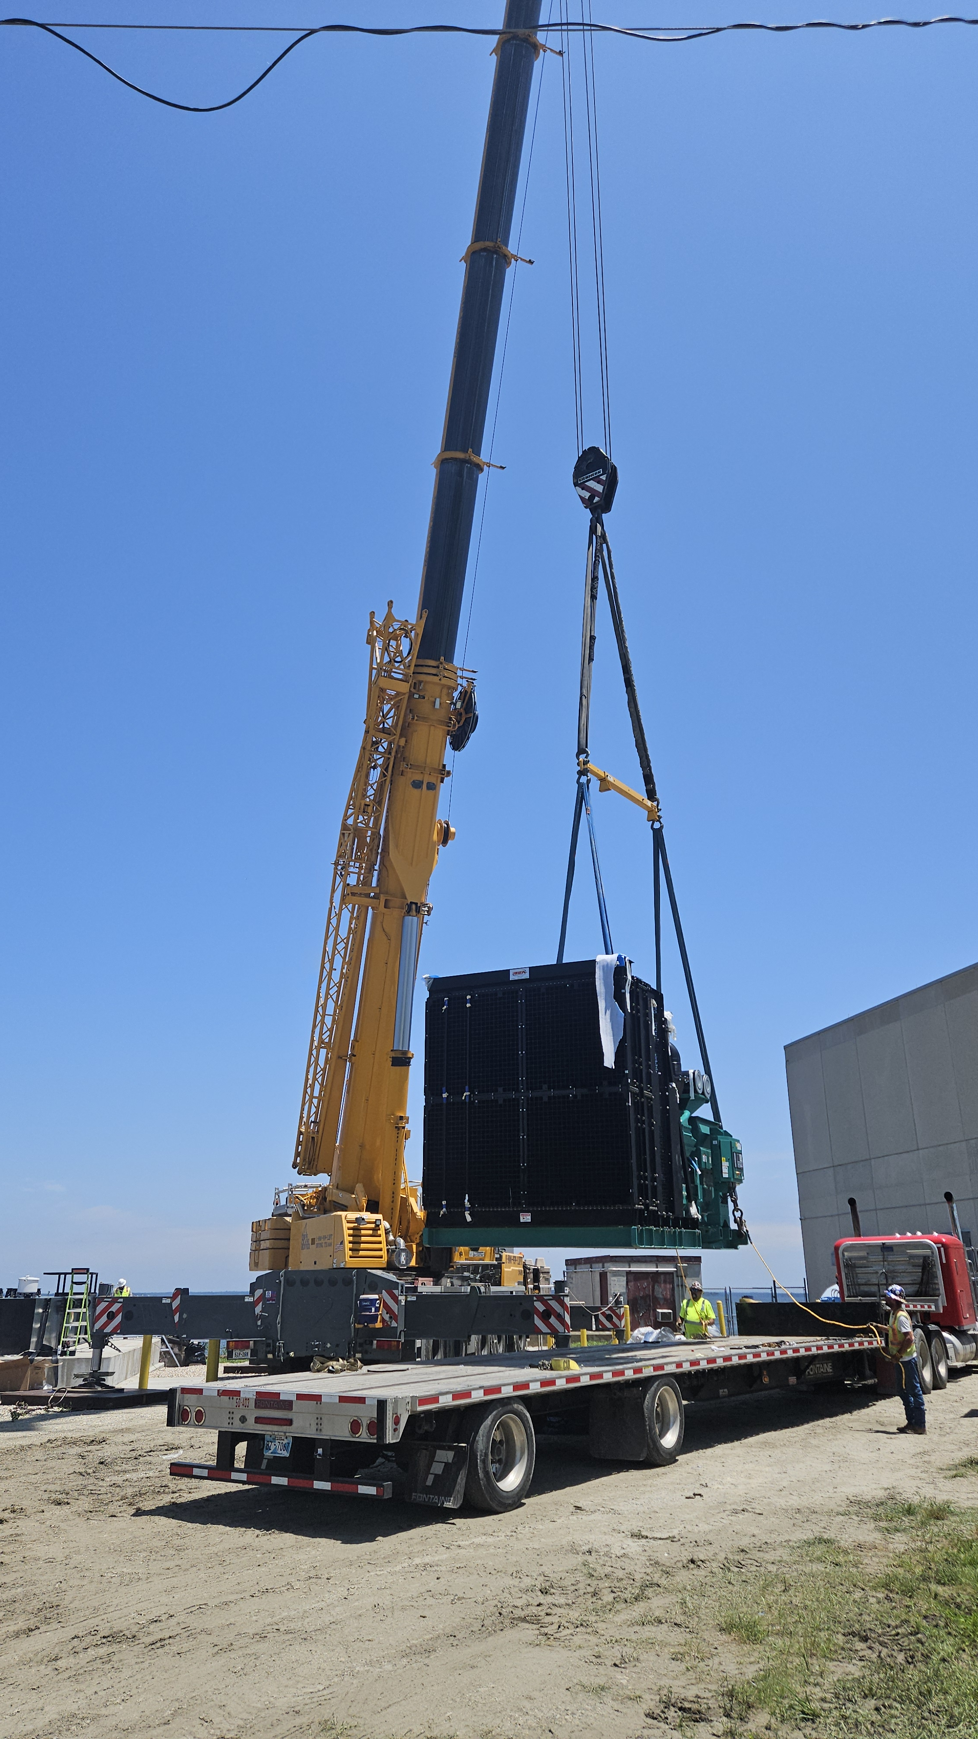
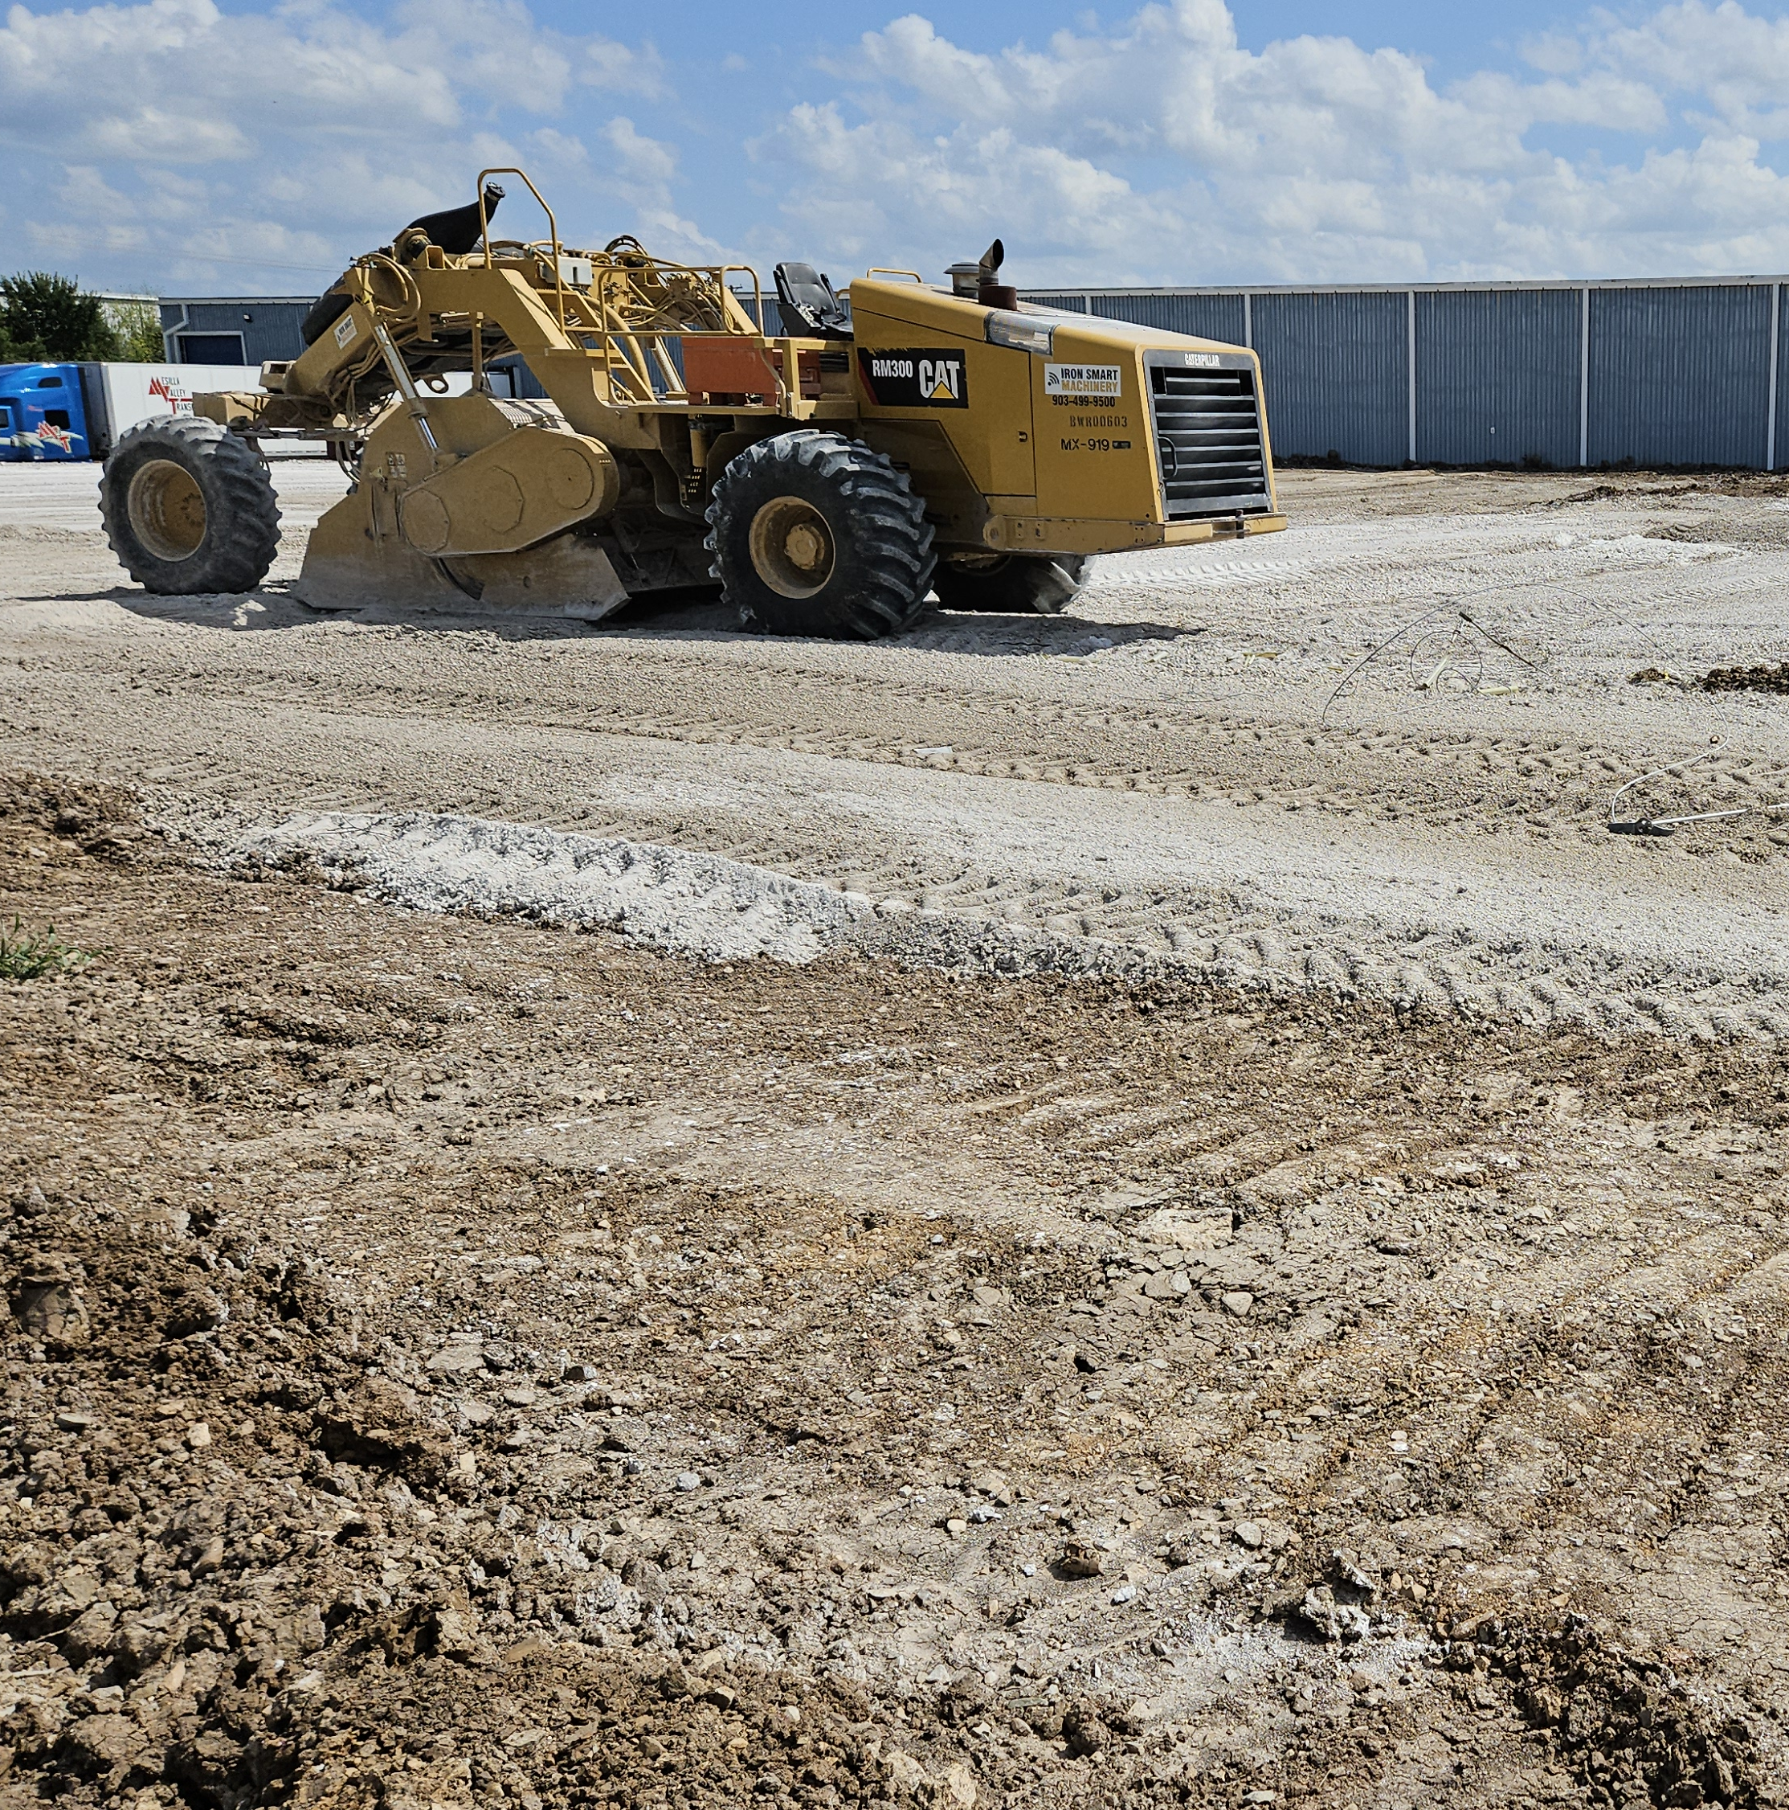
OUR DATA
5 - Safety Professionals
11 – Companies
126 - Report Forms
354 – Employees
1,019 - Pieces of Equipment
7,228 Reports In June 2024
44,967 Reports completed Year to Date

Slide 8
KPA = KPI -The DATA must be!
Specific
Measurable
Achievable
Relevant
Time Base

Slide 9

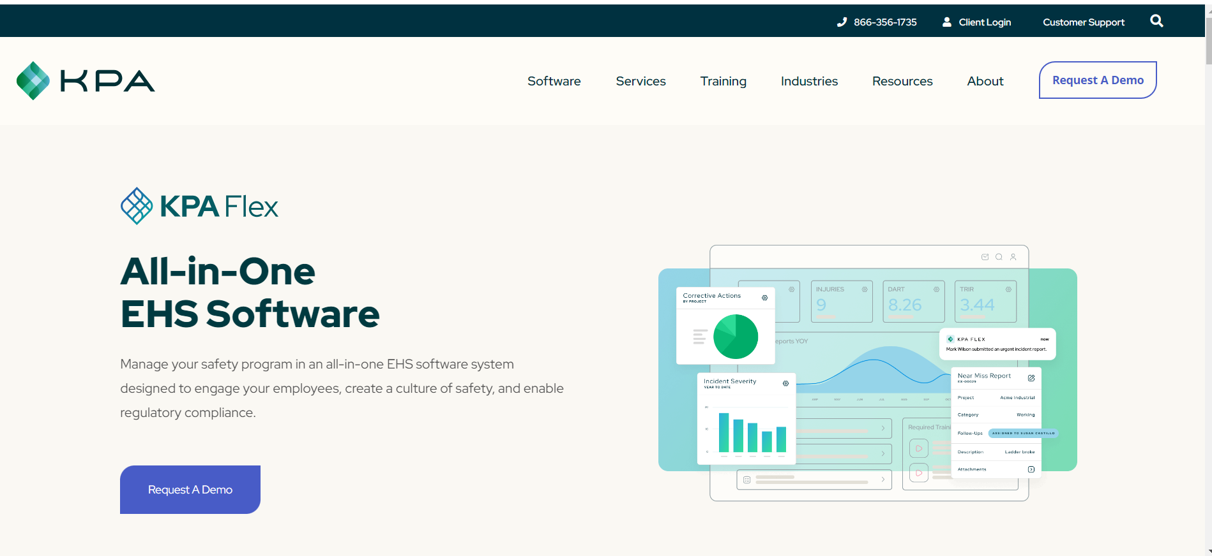

Slide 10
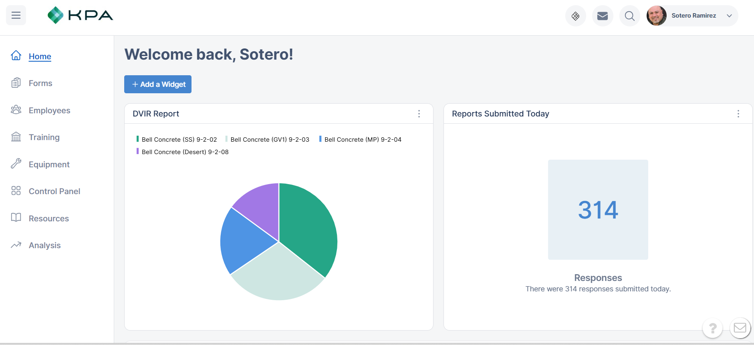
Fully Customizable Dashboard

Slide 11
Preload Or Custom Forms

Slide 12
Employee List

Slide 13
Training Status, Library, Upload, Lesson Data…..

Slide 14
Equipment Details

Slide 15
Access Controls

Slide 16
Employee Access to Recourses

Slide 17
Get the Picture

Slide 18
Conclusion
Have a System that meets your needs.
Look at the data to manage the team.
Keep everyone on the same page.
Keeps company scalable.
Information is mobile.

